Slide 1
Lecture 13
Javascript

Slide 2
Previous Lecture
Object Oriented Programming
Location
Window

Slide 3
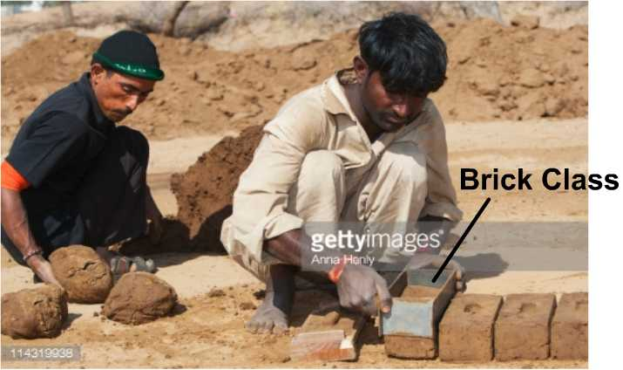
Previous Lecture
Object Oriented Programming
Maps with the real world scenarios. i.e. define a template and start getting products out of that template.
create-react-app myproject

Slide 4
Today’s Lecture
Form Validation with select, radio and checkboxes.

Slide 5
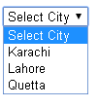
Form Validation (Select)
if(mySelect.selectedIndex == 0){ //please select a city }

Slide 6
Form Validation (radio)
FSC <input name="program" type="radio">
ISC <input name="program"type="radio">
var programSelected = document.querySelectorAll('input[name=program]:checked');
if(!programSelected.length){ //please select a program }

Slide 7
Handling errors in JavaScript
Normally, when an error occurs in a JavaScript, subsequent code does not execute.
In order to properly handle errors to prevent the code from being executed, we use try catch structure

Slide 8
Handling errors in JavaScript
try{
//Dangerous code goes here
}catch(err){
//err object will hold the error details //Handle the error here }

Slide 9
Generating Errors
Use throw to push an error response
Example>
throw “Your error message goes here”;

Slide 10
Adding property to an object
var obj= {};
obj.name = ‘Khurram’;
More flexible method>
Object.defineProperty(obj, ‘password', options);

Slide 11
Switches
Switches are a more fast approach as compared to elseif conditions.
var city =‘Faisalabad’;
if(city == ‘Karachi’){
console.log(‘This is Karachi’);
} elseif(city == ‘Faisalabad’){ console.log(‘This is Faisalabad’);
} else{
console.log(‘No city found’)
}

Slide 12
Switches
var city = ‘Faisalabad’;
switch(city){
case 'Karachi':
console.log('This is Faisalabad');
break;
case 'Faisalabad':
console.log('This is Faisalabad');
break;
default:
console.log('No city found');
break;
}

Slide 13
A bit more about DOM
Each tag has childNodes property which return an array containing all child tags.
Example>
<div id=“myDiv">
<span>A</span>
<span>B</span>
</div>
myDiv.childNodes

Slide 14
Targeting elements
document.getElementById(‘myID’)
document.getElementsByClassName(‘programs’)
document.getElementsByTagName(‘section’)
document. getElementsByName(‘gender’)
document. querySelector(‘div.program’)
document. querySelectorAll(‘div#test’)

Slide 15
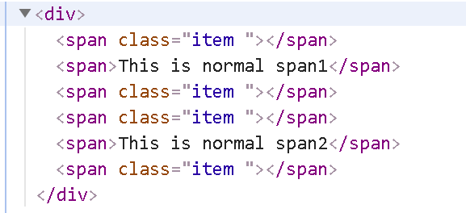
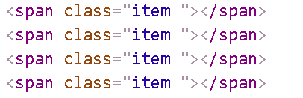
QuerySelector AND QUERYSELECTORALL
document. querySelectorAll(‘div.item’)

Slide 16
Binding Functions
We often need to persist the context of the function.
Problem>
var person = { name:’Khurram’,
sayName:function(){ console.log(this.name); //undefined
}
};
myButton.onclick = person.sayName;

Slide 17
Binding Functions
bind(context) returns the function with the context we passed into the bind function
var person = { name:’Khurram’,
sayName:function(){ console.log(this.name);
}
};
myButton.onclick = person.sayName.bind(person);

Slide 18
Today’s Assignment
Create an image slider.

Slide 19
What we have studies today?
DOM methods to extract desired elements
Try/Catch Clause
Binding Functions

